Slide 1
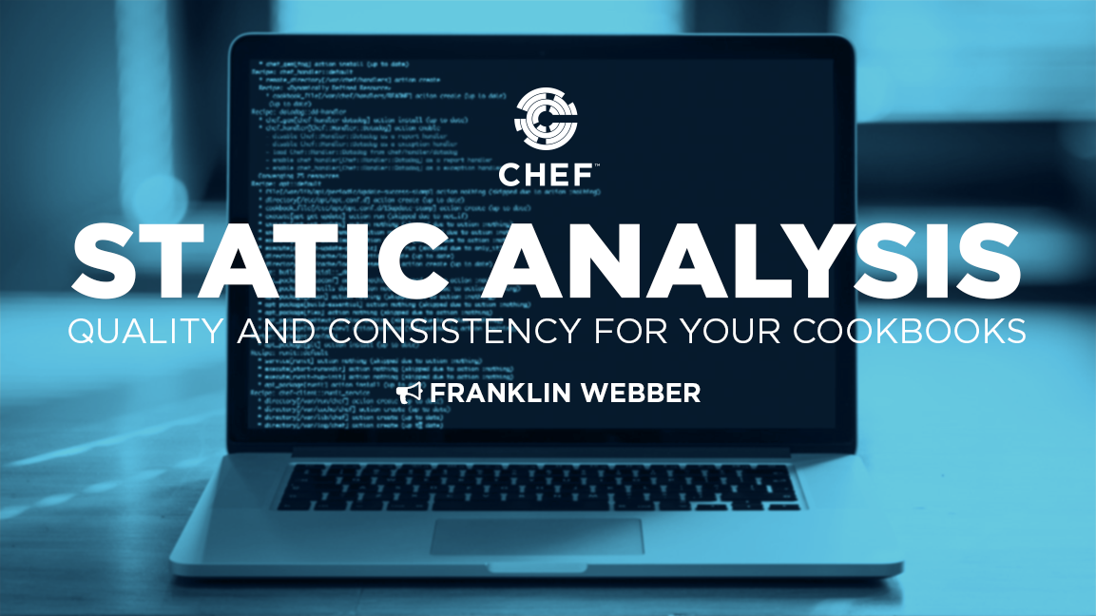
Name of Presentation
Name of Speaker

Slide 2
Franklin Webber
Trainer
Technical Support, Quality Assurance, Software Developer, Technical Trainer, Pokémon Trainer

Slide 3
Name of Presentation
Name of Speaker

Slide 4
Objectives
What is static analysis? Why am I here? What am I going to learn?
What is static analysis and where does it fit within the development cycle?
What is Foodcritic and how do I use it?
What is Rubocop and how do I use it?

Slide 5
Code Review
Peer review process to find and remove common vulnerabilities, improve portability, and share knowledge about the code base.

Slide 6
Static Analysis or Linting
An automated way to ensure that the code we write adheres to conventions that ensure code correctness, uniformity, portability, and uses best practices.

Slide 7


Current Cookbook Development Workflow
Write some cookbook code
Perform ad-hoc verification
Upload the cookbook to the Chef Server

Slide 8

Current Cookbook Development Workflow
Chef-client run retrieves the updated cookbook
Perform ad-hoc verification
Promote the cookbook to the next environment

Slide 9

Current Cookbook Development Workflow
Chef-client run retrieves the updated cookbook
Perform ad-hoc verification
Establish monitoring for deployed services

Slide 10
Current Cookbook Development Workflow
Write some cookbook code
Perform ad-hoc verification
Upload the cookbook to the Chef Server
Chef-client run retrieves the updated cookbook
Perform ad-hoc verification
Promote the cookbook to production environment
Chef-client run retrieves the updated cookbook
Perform ad-hoc verification
Establish monitoring for deployed services

Slide 11
Risk
Every change to our cookbooks introduces risk

Slide 12
Updated Cookbook Development Workflow
Write some cookbook code
Perform automated code linting
Perform automated unit testing
Deploy to a virtual deployment environment
Perform automated integration testing

Slide 13

Updated Cookbook Development Workflow
Watch for changes in the cookbook repository
Perform automated code linting
Perform automated unit testing
Deploy to a virtual deployment environment
Perform automated integration testing

Slide 14
Objectives
What is static analysis? Why am I here? What am I going to learn?
What is static analysis and where does it fit within the development cycle?
What is Foodcritic and how do I use it?
What is Rubocop and how do I use it?

Slide 15
More Choices, More Problems
Within chef cookbooks there are many ways to engineer solutions. Sometimes too many!
~ DevOps Unicorn

Slide 16

http://www.foodcritic.io

Slide 17
Community Cookbook Conventions
Rules created and defined by Chef developers to bring order to chaos. The goal is to provide tools and automation to adhere to standards voted on by their peers.
http://www.foodcritic.io

Slide 18
An incorrectly defined action
execute "tar xzf redis-2.8.9.tar.gz" do
cwd "/root"
action :rum
notifies :run, "execute[make]", :immed…
end
The execute resource supports two actions:
:run
and
:nothing
http://www.foodcritic.io/#FC038

Slide 19
Configurable
Foodcritic is able to turn on and off specific conventions that are important to your team's goals.
http://www.foodcritic.io

Slide 20
Obtaining Foodcritic
foodcritic is part of the standard set of utilities included with the Chef Development Kit.
http://downloads.chef.io/

Slide 21
Using foodcritic
foocritic is a command-line application that evaluates your cookbook against a set of conventions and then reports the violations.
http://downloads.chef.io/

Slide 22
foodcritic Your Cookbook
$ foodcritic cookbooks/iis
foodcritic will evaluate the cookbook found at the specified path.
https://docs.chef.io/foodcritic.html

Slide 23
Running foodcritic Within the Cookbook
$ cd cookbooks/redis
$ foodcritic .
foodcritic will evaluate the redis cookbook.

Slide 24
Community Conventions
It comes with 47 built-in rules that identify problems ranging from simple style inconsistencies to difficult to diagnose issues that will hurt in production.

Slide 25
Early and Often
The advantages of running foodcritic:
identify simple errors early
eliminating issues that violate conventions from the review process

Slide 26
Example results from foodcritic
FC003: Check whether you are running with chef server before using server-specific features: ./recipes/ip-logger.rb:1
FC008: Generated cookbook metadata needs updating: ./metadata.rb:2
FC008: Generated cookbook metadata needs updating: ./metadata.rb:3
https://docs.chef.io/foodcritic.html

Slide 27
Violations found by foodcritic
FC003: Check whether you are running with chef server before using server-specific features: ./recipes/ip-logger.rb:1
FC008: Generated cookbook metadata needs updating: ./metadata.rb:2
FC008: Generated cookbook metadata needs updating: ./metadata.rb:3
https://docs.chef.io/foodcritic.html

Slide 28
Reading results from foodcritic
FC003: Check whether you are running with chef server before using server-specific features: ./recipes/ip-logger.rb:1
FC008: Generated cookbook metadata needs updating: ./metadata.rb:2
FC008: Generated cookbook metadata needs updating: ./metadata.rb:3
FOODCRITIC (FC) VIOLATION:MESSAGE:FILEPATH: LINE NUMBER
https://docs.chef.io/foodcritic.html

Slide 29
Reading results from foodcritic
FC003: Check whether you are running with chef server before using server-specific features: ./recipes/ip-logger.rb:1
FC008: Generated cookbook metadata needs updating: ./metadata.rb:2
FC008: Generated cookbook metadata needs updating: ./metadata.rb:3
Rule Number: FC003 or Food Critic Violation 003
Message: Check whether you are running with chef server before us…
File path: ./recipes/ip-logger.rb
Line Number: 1
https://docs.chef.io/foodcritic.html

Slide 30
Violation Message
Check whether you are running with chef server before using server-specific features.
http://www.foodcritic.io/#FC003

Slide 31
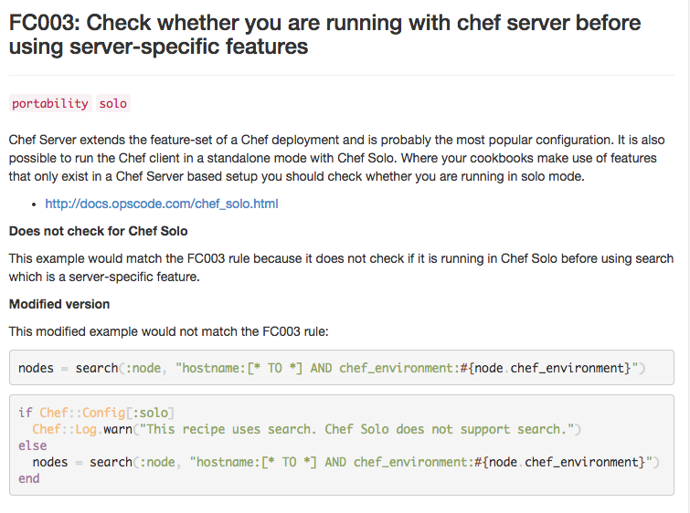
http://www.foodcritic.io/#FC003

Slide 32
Specific foodcritic rules only
$ foodcritic -t FC003 cookbooks/mysql
Run foodcritic to evaluate the mysql cookbook, in the cookbooks directory, if it violates Food Critic Rule 003 (FC003).
http://www.foodcritic.io/#FC003

Slide 33
Everything except that foodcritic rule
$ foodcritic -t ~FC003 cookbooks/mongodb
Run foodcritic to evaluate the mongodb cookbook, in the cookbooks directory, if it violates every rule except Food Critic Rule 003 (FC003).
http://www.foodcritic.io/#FC003

Slide 34
foodcritic rules are tagged
$ foodcritic -t services .
$ foodcritic -t ~style .
Run foodcritic to evaluate the current cookbook if it violates all rules tagged as services.
Run foodcritic to evaluate the current cookbook if it violates all the rules except the ones tagged as style.
http://www.foodcritic.io

Slide 35
foodcritic rules combined
$ foodcritic -t services -t ~style -t ~FC002 .
Run foodcritic to evaluate the current cookbook if it violates all rules tagged as services but not if they are also style rules or food critic violation 002 (FC002).
http://www.foodcritic.io

Slide 36
foodcritic rules combined
$ foodcritic -t services -t ~style -t ~FC002 .
$ echo "services,~style,~FC002" > .foodcritic
When I run foodcritic with no parameters I want the default rules to be:
all rules tagged as services but not if they are also style rules or food critic violation 002 (FC002).
http://www.foodcritic.io

Slide 38
Objectives
What is static analysis? Why am I here? What am I going to learn?
What is static analysis and where does it fit within the development cycle?
What is Foodcritic and how do I use it?
What is Rubocop and how do I use it?

Slide 39
Chef is Ruby
Chef is a domain specific language (DSL) added on top of Ruby. Most every file within your cookbook is a ruby file.

Slide 40







All of it is Ruby

Slide 41


Slide 42
Ruby Style Guidelines
Rubocop feedback shows you where the code violates ruby community conventions, display warnings, potential errors, and even fatal errors

Slide 43
Example Recipe
package "httpd"
template "/var/www/html/index.html" do
source "index.html.erb"
end
service "httpd" do
action [ :enable, :start ]
end
The ruby community expects the use of two space indention.
Rubocop would complain about three spaces or the use of tabs.

Slide 44
Chef Community
Ruby Community

Slide 45
Configurable
Rubocop is able to turn on and off specific 'cops' that don't match your organization's conventions.

Slide 46
Obtaining Rubocop
rubocop is part of the standard set of utilities included with the Chef Development Kit.
http://downloads.chef.io/

Slide 47
Using Rubocop
rubocop is a command-line application that checks your ruby code.
http://downloads.chef.io/

Slide 48
Running rubocop Within the Cookbook
$ cd cookbooks/apache
$ rubocop
rubocop will evaluate the apache cookbook.

Slide 49
rubocop Your Cookbook
$ rubocop path/to/cookbook
rubocop will evaluate the cookbook found at the specified path.
https://docs.chef.io/rubocop.html

Slide 50
rubocop Your Cookbook
$ rubocop cookbooks/iis
rubocop will evaluate the iis cookbook.
https://docs.chef.io/rubocop.html

Slide 51
rubocop More Cookbooks
$ rubocop cookbooks/mongodb cookbooks/mysql
rubocop will evaluate the mongodb cookbook and the mysql cookbook
https://docs.chef.io/rubocop.html

Slide 52
Somewhere there is a crime happening!
examines all ruby files (*.rb) against a suite of cops.

Slide 53
Enforce The Law!
Each cop examines the code from different perspectives to:
Enforce style conventions
Enforce best practices within Ruby
Evaluate the code against metrics

Slide 54
Early and Often
The advantages of running rubocop:
identify simple errors early
eliminating style choices from the review process

Slide 55
Example results from rubocop
Inspecting 8 files
C.CWCEFF
Offenses:
cookbooks/apache/attributes/default.rb:1:1: C: Missing utf-8 encoding comment.
default["apache"]["indexfile"] = "index1.html"
^
https://docs.chef.io/rubocop.html

Slide 56
Example results from rubocop
Inspecting 8 files
C.CWCEFF
Offenses:
cookbooks/apache/attributes/default.rb:1:1: C: Missing utf-8 encoding comment.
default["apache"]["indexfile"] = "index1.html"
^
`.` means that the file contains no issues
`C` means a issue with convention
`W` means a warning
`E` means an error
`F` means an fatal error
https://docs.chef.io/rubocop.html

Slide 57
Example results from rubocop
Inspecting 8 files
C.CWCEFF
Offenses:
cookbooks/apache/attributes/default.rb:1:1: C: Missing utf-8 encoding comment.
default["apache"]["indexfile"] = "index1.html"
^
https://docs.chef.io/rubocop.html

Slide 58
Example results from rubocop
Inspecting 8 files
C.CWCEFF
Offenses:
cookbooks/apache/attributes/default.rb:1:1: C: Missing utf-8 encoding comment.
default["apache"]["indexfile"] = "index1.html"
^
FILENAME:LINE_NUMBER:CHARACTER_NUMBER: TYPE_OF_ERROR: MESSAGE
https://docs.chef.io/rubocop.html

Slide 59
Example results from rubocop
Inspecting 8 files
C.CWCEFF
Offenses:
cookbooks/apache/attributes/default.rb:1:1: C: Missing utf-8 encoding comment.
default["apache"]["indexfile"] = "index1.html"
^
FILENAME:LINE_NUMBER:CHARACTER_NUMBER: TYPE_OF_ERROR: MESSAGE
SOURCE CODE
https://docs.chef.io/rubocop.html

Slide 60
Example results from rubocop
Inspecting 8 files
C.CWCEFF
Offenses:
cookbooks/apache/attributes/default.rb:1:1: C: Missing utf-8 encoding comment.
default["apache"]["indexfile"] = "index1.html"
^
FILENAME:LINE_NUMBER:CHARACTER_NUMBER: TYPE_OF_ERROR: MESSAGE
SOURCE CODE
^ (points to the location of the issue in source)
https://docs.chef.io/rubocop.html

Slide 61
Display cops enforced by rubocop
$ rubocop --show-cops
# Available cops (218) + config for /Users/webber/source/ark:
# Type 'Lint' (38):
Lint/AmbiguousOperator:
Description: Checks for ambiguous operators in the first argument of a method invocation
without parentheses.
StyleGuide: https://github.com/bbatsov/ruby-style-guide#parens-as-args
https://docs.chef.io/rubocop.html

Slide 62
Display cops enforced by rubocop
$ rubocop --show-cops
# Available cops (218) + config for /Users/webber/source/ark:
# Type 'Lint' (38):
Lint/AmbiguousOperator:
Description: Checks for ambiguous operators in the first argument of a method invocation
without parentheses.
StyleGuide: https://github.com/bbatsov/ruby-style-guide#parens-as-args
https://docs.chef.io/rubocop.html

Slide 63
Running only one cop
$ rubocop --only Lint/AmbiguousOperator
Inspecting 53 files
.....................................................
53 files inspected, no offenses detected
https://docs.chef.io/rubocop.html

Slide 64
Enabled Cops
https://github.com/bbatsov/rubocop/blob/master/config/enabled.yml

Slide 65
Disabled Cops
https://github.com/bbatsov/rubocop/blob/master/config/disabled.yml

Slide 66
Configurable
Rubocop is able to turn on and off specific 'cops' that don't match your organization's conventions.

Slide 67
Defining a config file in the cookbook
.rubocop.yml
AlignParameters:
Enabled: false
Encoding:
Enabled: false
LineLength:
Max: 200
StringLiterals:
Enabled: false

Slide 68
Disabled
.rubocop.yml
AlignParameters:
Enabled: false
Encoding:
Enabled: false
LineLength:
Max: 200
StringLiterals:
Enabled: false

Slide 69
Disabled
.rubocop.yml
AlignParameters:
Enabled: false
Encoding:
Enabled: false
LineLength:
Max: 200
StringLiterals:
Enabled: false

Slide 70
The Names of the Cops
AlignParameters:
Enabled: false
Encoding:
Enabled: false
LineLength:
Max: 200
StringLiterals:
Enabled: false
CATEGORY/NAME_OF_COP:
Enabled: (true or false)
KEY: VALUE

Slide 71
Enabling / Disabling Cops
AlignParameters:
Enabled: false
Encoding:
Enabled: false
LineLength:
Max: 200
StringLiterals:
Enabled: false
CATEGORY/NAME_OF_COP:
Enabled: (true or false)
KEY: VALUE

Slide 72
Cops with Custom Values
AlignParameters:
Enabled: false
Encoding:
Enabled: false
LineLength:
Max: 200
StringLiterals:
Enabled: false
CATEGORY/NAME_OF_COP:
Enabled: (true or false)
KEY: VALUE

Slide 73
rubocop load order
1
rubocop/config/enabled.yml
2
rubocop/config/disabled.yml
3
.rubocop.yml

Slide 74
Generating a .rubocop-todo.yml
$ rubocop --auto-gen-config
Inspecting 8 files
C.CWCEFF
...
...
8 files inspected, 50 offenses detected
Created .rubocop_todo.yml

Slide 75
Accepting Your Faults and The Standard
$ mv .rubocop_todo.yml .rubocop.yml
If everything that Rubocop complained about is your new defined standard.

Slide 77
Objectives
What is static analysis? Why am I here? What am I going to learn?
What is static analysis and where does it fit within the development cycle?
What is Foodcritic and how do I use it?
What is Rubocop and how do I use it?

Slide 78
Q&A
What questions can I answer for you?

Slide 79
https://downloads.chef.io/chef-dk

Slide 80
Name of Presentation
Name of Speaker

